Slide 1


Copilot in SharePoint & OneDrive: The path toward efficient and
Intelligent document management
Juan Carlos Gonzalez | Microsoft 365 & Microsoft 365 Copilot MVP | M365 SME & Delivery Manager
Notes:
Copilot in SharePoint & OneDrive: The path toward efficient and intelligent document management

Slide 2








@jcgm1978 | @jcgm1978.bsky.social
jcgonzalezmartin1978@hotmail.com
https://nl.linkedin.com/in/juagon
https://jcgonzalezmartin.wordpress.com/
https://www.youtube.com/@jcgonzalezmartin
https://office365itpros.com/

Slide 3
Agenda
SharePoint + OneDrive and their Key Role in Microsoft 365
Copilot in SharePoint (aka AI Actions) + Copilot in OneDrive: Use Cases
Copilot in OneDrive for Business + OneDrive Agents
AI Actions for SharePoint Sites
Prerequisites for Copilot in OneDrive for Business & AI Actions for SharePoint Sites
Copilot in OneDrive for Business & AI Actions for SharePoint Sites limits
Roadmap
Conclusions & References
Notes:
SharePoint + OneDrive and Their Key Role in Microsoft 365
Copilot in SharePoint (aka AI Actions) + Copilot in OneDrive: Use Cases
Copilot in OneDrive for Business
AI Actions for SharePoint Sites
Prerequisites Copilot in OneDrive for Business & AI Actions for SharePoint Sites
Copilot in OneDrive & AI Actions for SharePoint Sites limits
Roadmap
Conclusions & References

Slide 4
SharePoint + OneDrive and their Key Role in Microsoft 365
Notes:
SharePoint + OneDrive and Their Key Role in Microsoft 365
Copilot in SharePoint (aka AI Actions) + Copilot in OneDrive: Use Cases
Copilot in OneDrive for Business
AI Actions for SharePoint Sites
Prerequisites Copilot in OneDrive for Business & AI Actions for SharePoint Sites
Copilot in OneDrive for Business & AI Actions for SharePoint Sites limits
Roadmap
Conclusions & References

Slide 5














Slide 6
> 2-3,000 Million Files
> 3,000 Million Flows
> 2 Million Sites
Added every day
orchestrating content every week
created daily

Slide 7
Copilot in SharePoint (aka AI Actions) + Copilot in OneDrive: Use Cases
Notes:
SharePoint + OneDrive and Their Key Role in Microsoft 365
Copilot in SharePoint (aka AI Actions) + Copilot in OneDrive: Use Cases
Copilot in OneDrive for Business
AI Actions for SharePoint Sites
Prerequisites Copilot in OneDrive for Business & AI Actions for SharePoint Sites
Copilot in OneDrive & AI Actions for SharePoint Sites limits
Roadmap
Conclusions & References

Slide 8
Copilot in SharePoint + Copilot in OneDrive:
Use Cases
Catch up
Create new content
Such as: FAQ, Executive Summaries, User Guides, Audio overviews and more
On multiple files by quickly summarizing them
Ask Questions + Analyze Content
On information in your files and Copilot will give you answers directly in chat
You don't need to search and open files to get what you're looking for, simply ask Copilot and get answers
By getting main points and insights on files without having to read them
Compare Files
By creating a table or a text summary that compares two or more files without having to open and close those files
Notes:
Ask questions on information in your files and Copilot will give you answers directly in chat. Now you don't need to search and open files to get what you're looking for, simply ask Copilot and get answers.
Copilot can help you catch up on multiple files by quickly summarizing them. Need to get the main points of an 80-page PDF report before a meeting? Just ask Copilot!
Reference existing files in your OneDrive to get Copilot's help on things like preparing FAQs, recommendations on improving a file for an executive meeting, or comparing the main differences between two documents.
Copilot is also great at helping you compare the differences between two or more files. You can ask Copilot to create a table or a text summary of two or more files without having to open and close your files.

Slide 9


Copilot in SharePoint + Copilot in OneDrive:
Use Cases
Use Case / Use | Copilot in SharePoint | Copilot in OneDrive
Create custom Agents
Summarize one or several documents (Office, PDF)
Summarize SharePoint pages
Create Audio Overviews (Word, PDF, PowerPoint)
Ask questions about one or several documents
Ask questions about images
Compare documents
Generate content from the selected file (FAQ, Executive Summary, etc.)
Provide answers on specific topics
Generate a summary when sharing a file
Copilot button in the Microsoft 365 universal file viewer

Slide 10
Copilot in OneDrive for Business + OneDrive Agents
Notes:
SharePoint + OneDrive and Their Key Role in Microsoft 365
Copilot in SharePoint (aka AI Actions) + Copilot in OneDrive: Use Cases
Copilot in OneDrive for Business
AI Actions for SharePoint Sites
Prerequisites Copilot in OneDrive for Business & AI Actions for SharePoint Sites
Copilot in OneDrive & AI Actions for SharePoint Sites limits
Roadmap
Conclusions & References

Slide 11

Copilot in OneDrive for Business
Key features
Always On through the Copilot Button
1
It allows users to make and interact with their documents through natural language questions
2
Four main use cases: Extract information from multiple files (up to 5) without having to open them | Compare Differences Between Files | Quick File Summary | Generate Insights from the files
3
Generating New Content (Including Audio Summaries) from a File
4

Slide 12


Demo #1: Copilot in OneDrive for Business
Notes:
Copilot Button in OneDrive
Copilot in OneDrive for Business
Copilot button in the Microsoft 365 Universal File Viewer
Copilot when sharing file

Slide 13



OneDrive Agents: Steps to create a Copilot Agent
for OneDrive
Customize branding and purpose
Indicate content that the agent should collect information about
Define the Startup Prompts related to the Agent's purpose and scope

Slide 14



OneDrive Agents: Steps to create a Copilot Agent
for OneDrive
Tips, Recommendations & Best Practices to create an Agent (They also apply to SharePoint Agents):
Quality
Organization
Feedback
Be sure to configure the Agent to use reviewed, accurate, complete, and unique content
The better the content, the better the agent will behave and provide accurate and relevant + answers
Organize content into small, manageable document sets to improve response accuracy
It is better to configure the Agent with few documents and minimal graphics for a better experience
Asks users for continuous feedback on the Agent's answers
Use Feedback to improve the accuracy of the Agent as much as possible

Slide 15
Demo #2: Agents in OneDrive (& SharePoint)
Notes:
Create an Agent in OneDrive for Business

Slide 16
AI Actions for SharePoint Sites
Notes:
SharePoint + OneDrive and Their Key Role in Microsoft 365
Copilot in SharePoint (aka AI Actions) + Copilot in OneDrive: Use Cases
Copilot in OneDrive for Business
AI Actions for SharePoint Sites
Prerequisites Copilot in OneDrive for Business & AI Actions for SharePoint Sites
Copilot in OneDrive & AI Actions for SharePoint Sites limits
Roadmap
Conclusions & References

Slide 17
AI Actions for SharePoint Actions
Key features
Available in the Document Libraries command bar
1
They mirror the same actions available in OneDrive to enhance productivity when interacting with files through natural language prompts
2
The use cases and scenarios are the same ones we have in OneDrive for Business
3
Notes:
These actions mirror those currently available in OneDrive and offer enhanced productivity by enabling users to interact with files using natural language prompts.

Slide 18
Demo #3: AI Actions for SharePoint Sites
Notes:
AI Actions for SharePoint Sites
Copilot button in the Microsoft 365 Universal File Viewer
Copilot when sharing file

Slide 19
Prerequisites for Copilot in OneDrive and AI Actions for SharePoint Sites
Notes:
SharePoint + OneDrive and Their Key Role in Microsoft 365
Copilot in SharePoint (aka AI Actions) + Copilot in OneDrive: Use Cases
Copilot in OneDrive for Business
AI Actions for SharePoint Sites
Prerequisites Copilot in OneDrive for Business & AI Actions for SharePoint Sites
Copilot in OneDrive & AI Actions for SharePoint Sites limits
Roadmap
Conclusions & References

Slide 20



Prerequisites for Copilot in OneDrive, OneDrive Agents
and AI Actions for SharePoint Sites
Microsoft 365 Copilot licenses
Set up Pay as You Go for Copilot Agents
Notes:
Prerequisites for Copilot in OneDrive and AI Actions for SharePoint Sites

Slide 21
Copilot in OneDrive and AI Actions for SharePoint Sites limits
Notes:
SharePoint + OneDrive and Their Key Role in Microsoft 365
Copilot in SharePoint (aka AI Actions) + Copilot in OneDrive: Use Cases
Copilot in OneDrive for Business
AI Actions for SharePoint Sites
Prerequisites Copilot in OneDrive for Business & AI Actions for SharePoint Sites
Copilot in OneDrive & AI Actions for SharePoint Sites limits
Roadmap
Conclusions & References

Slide 22
Copilot in OneDrive and AI Actions for SharePoint
Sites limits
Supported File Types
Copilot Agents for OneDrive limits
Similar limits we know for SharePoint Agents:
Office documents: DOC, DOCX, PPT, PPTX, XLSX
Copilot in OneDrive & AI Actions for SharePoint Sites: # of Files it operates
Up to a maximum of 5 Files (Note: User files or files that have been shared with the user)
No folders are supported at the moment
Universal formats: PDF, TXT, RTF
Web Files: ASPX, HTM, HTML
OpenDocument formatted documents: ODT, ODP
Other file types: Images, OneNote, Meetings Recordings
20 source items: Folders, Files
Notes:
Copilot in OneDrive and AI Actions for SharePoint Sites limits

Slide 23
Roadmap
Notes:
SharePoint + OneDrive and Their Key Role in Microsoft 365
Copilot in SharePoint (aka AI Actions) + Copilot in OneDrive: Use Cases
Copilot in OneDrive for Business
AI Actions for SharePoint Sites
Prerequisites Copilot in OneDrive for Business & AI Actions for SharePoint Sites
Copilot in OneDrive & AI Actions for SharePoint Sites limits
Roadmap
Conclusions & References

Slide 24
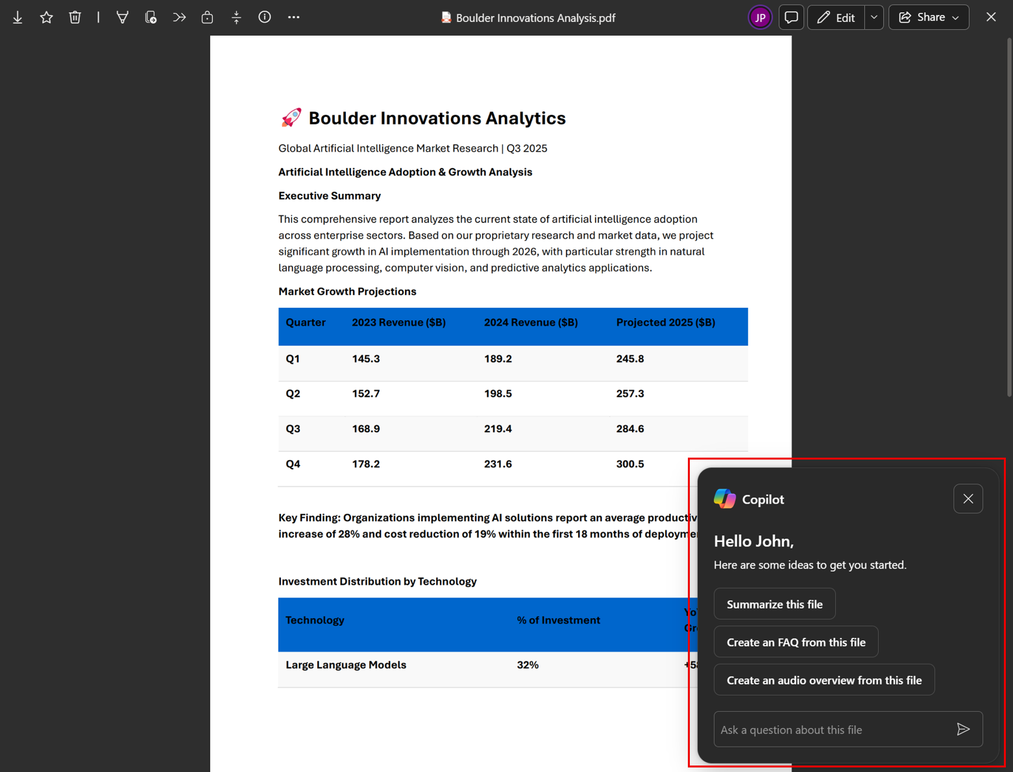
Roadmap: Rolling out + In Development features
Copilot Floating button in the universal file viewer

Slide 25
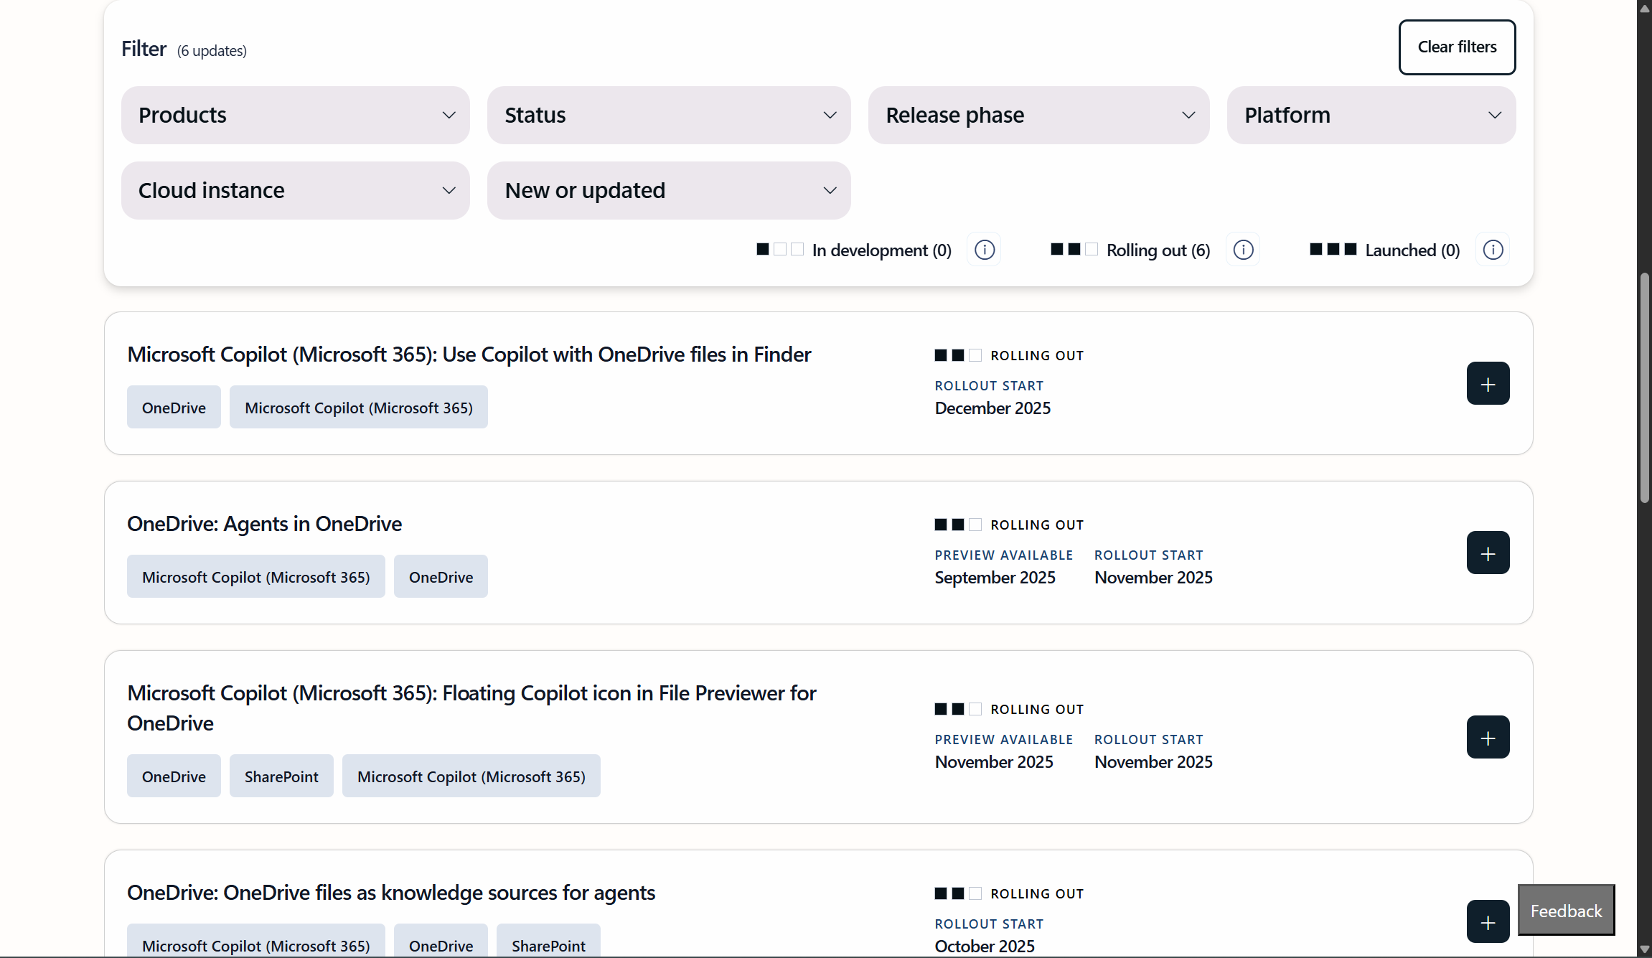
Roadmap: Rolling out + In Development features

Slide 26
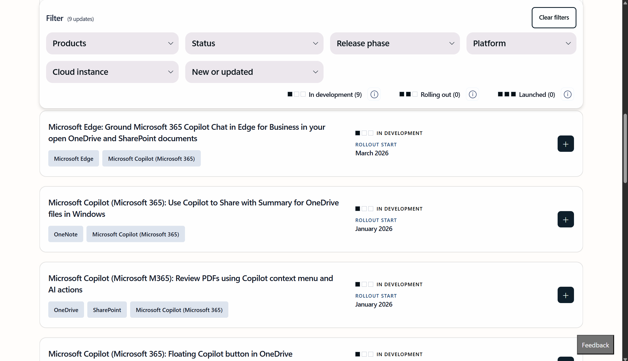
Roadmap: Rolling out + In Development features

Slide 27
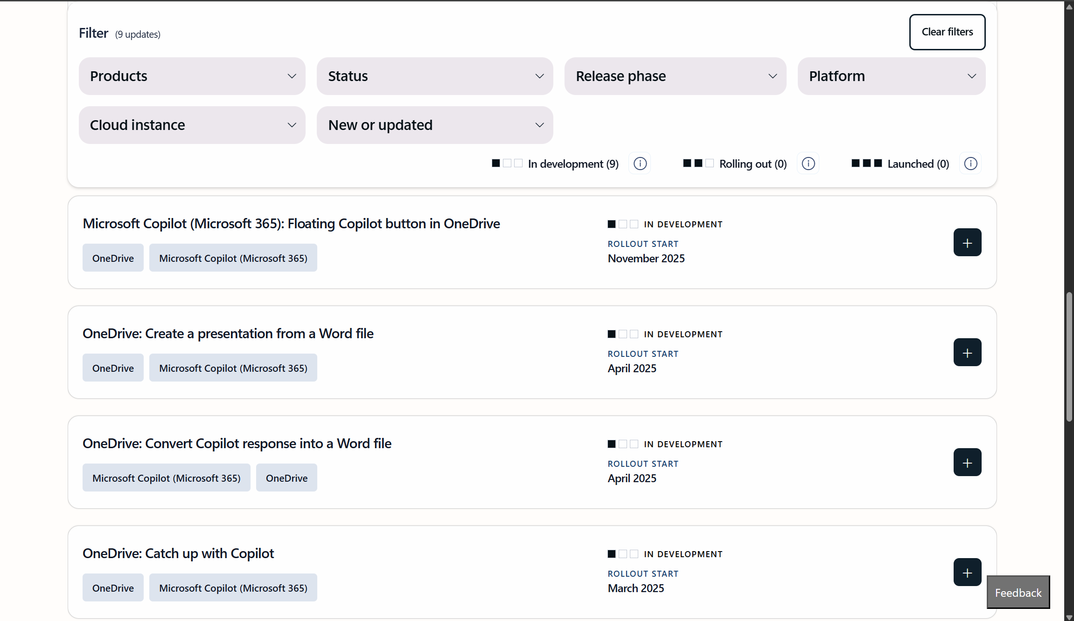
Roadmap: Rolling out + In Development features

Slide 28
Roadmap: Smarter search & answers in OneDrive

Slide 29
Roadmap: Researcher Agent integration
Notes:
M365 Copilot Researcher integration in OneDrive allowing you to go from files to strategy in just a few clicks.

Slide 30
Session Recap + References
Notes:
SharePoint + OneDrive and Their Key Role in Microsoft 365
Copilot in SharePoint (aka AI Actions) + Copilot in OneDrive: Use Cases
Copilot in OneDrive for Business
AI Actions for SharePoint Sites
Prerequisites Copilot in OneDrive for Business & AI Actions for SharePoint Sites
Copilot in OneDrive & AI Actions for SharePoint Sites limits
Roadmap
Conclusions & References

Slide 31
Session Recap
Copilot in SharePoint & Copilot in OneDrive make it easy to discover, consume, and share user-accessed information quickly and easily
Use cases for both Copilot flavors are the following: Extracting information from multiple files (up to 5) | Compare Differences Between Files | Quick File Summary | Generate Insights from the files | Generate Audio overviews
Copilot Agents in OneDrive are an extension of SharePoint Agents, but focused on your personal content
You have to know how to manage expectations in the use and behavior of Copilot in SharePoint & Copilot in OneDrive taking into account the current limitations that will be overcome over time
Notes:
Copilot in SharePoint & Copilot in OneDrive make it easy to discover, consume, and share user-accessed information quickly and easily
Copilot in OneDrive is focused on use cases such as: Extracting information from multiple files (up to 5) | Compare Differences Between Files | Quick File Summary | Generate Insights from the files
Copilot Agents for SharePoint support and extend Copilot use cases in OneDrive
Every SharePoint site has a default Agent and Additional Agents can be created
You have to know how to manage expectations in the use and behavior of Copilot & Copilot Agents in OneDrive taking into account the current limitations that will be overcome over time

Slide 32
Key references
Copilot + OneDrive: Intelligence in Every Click, Inspiration in Every Memory | Microsoft Community Hub
Microsoft 365: Copilot + OneDrive
Get started with Copilot in OneDrive - Microsoft Support
UX Updates, AI Actions & Forms in Document Libraries | Microsoft Community Hub
Frequently asked questions about Copilot in SharePoint - Microsoft Support

Slide 33
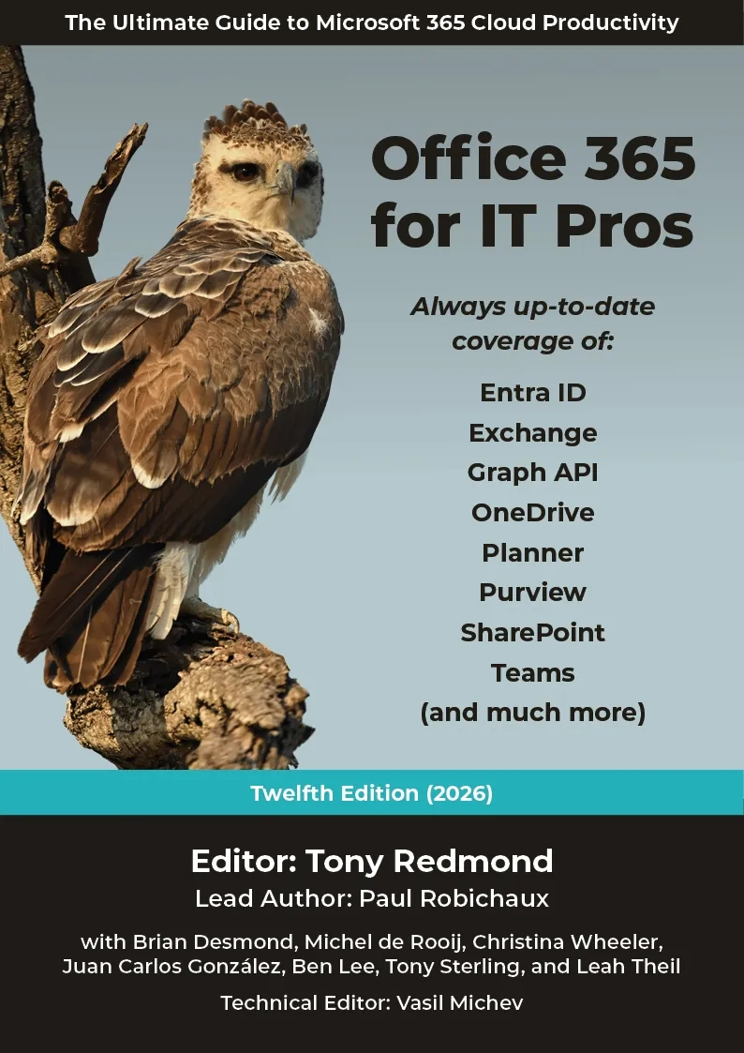
Office 365 for IT Pros
The best way to stay up to date with Microsoft 365:
Office 365 for IT Pros (2026 Edition). The Ultimate Guide to Managing Microsoft 365. (Includes the Automating Microsoft 365 with PowerShell eBook)

Slide 34

Questions?

